Slide 1

PRACTICAL APPRACHOS FOR SOLVING LOST CIRCULATION PROBLEMS WHILE DRILLING
TEAM MEMBERS
SAKTHI DOSS .S (17612913)
RAJKUMAR .M (17612113)
UNDER THE GUIDANCE OF
MR. VIVEK TAMIZHMANI B.E,M.S,Petro
(Head Of Department Of Petroleum Engineering , VISTAS)

Slide 2
ABSTRACT
As the demand for petroleum resources increases, drilling of oil and gas wells are often carried out in challenging and hostile environments. Among the top ten drilling challenges facing the oil and gas industry today is the problem of lost circulation. Major progress has been made to understand this problem and how to combat it. However, most of the products and guidelines available for combating lost circulation are often biased towards advertisement for a particular service company. The purpose of this study is to develop practical guidelines that are general and not biased towards a particular service company product and which will also serve as a quick reference guide for lost circulation prevention and control at the well-site for drilling personnel.

Slide 3
CONTENTS
INTRODUCTION
RESEARCH OBJECTIVES
RESEARCH METHODOLOGY
FUNDAMENTALS OF LOST CIRCULATION CONTROL
LOST CIRCULATION MATERIALS SELECTION (LCMs)
BORHOLE STABILITY ANALYSIS
MANAGEMENT OF EQUIVALENT CIRCULATION DENSITY
TYPES OF LOSSES IN THE LOST CIRCULATION

Slide 4
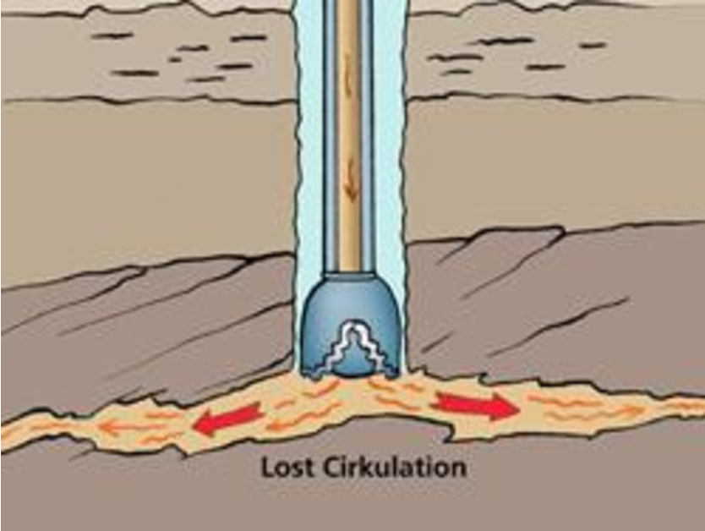
INTRODUCTION
LOST CIRCULATION:
Loss of drilling fluid into the formation during drilling,
Circulating or running casing.
One of the major problems in drilling operation.
Such problems in drilling are not confined to any area;
they may occurs any depth.
The zone where the mud is lost is called thief zone or lost
Circulation zone.

Slide 5
RESEARCH OBJECTIVES
The objectives of this study are as follows:
To review lost circulation control methods that have been applied in the drilling industry till date.
To provide the successes and the failures of the methods presented above in field applications.
To develop practical guidelines that will serve as a reference material for lost circulation control at the well-site for drilling personnel.

Slide 6
RESEARCH METHODOLOGY
The objectives of this study will be achieved through the following methods:
Read various technical journals, papers and textbooks that talk on the subject of lost circulation control over the years in the drilling industry.
Summarize these technical materials based on the various lost circulation control methods used over time, their success stories, and their failures in various field applications.
Develop practical guidelines based on the above methods.

Slide 7
FUNDAMENTALS OF LOST CIRCULATION CONTROL
A lot of effort has been done to understand the mechanics of lost circulation control. Lost circulation control during well construction is more than just selecting the right lost circulation material (LCM) but requires a complete engineered approac.
borehole stability analysis,
equivalent circulating density (ECD) modelling,
leak-off flow-path geometry considerations,
drilling fluid and LCM selection to help minimize effects on ECD,
on-site monitoring using annular pressure while drilling (APWD)

Slide 8
LOST CIRCULATION MATERIALS (LCMs) SELECTION
Conventional lost circulation material
Fibers, flakes,
And granules
High fluid loss squeezes
Diatomaceous earth or clay blend
Gunk slurries
Diesel oil bentonite
Source: Lost circulation material selection in drilling operation

Slide 9
BOREHOLE STABILITY ANALYSIS
To effectively prevent and cure losses resulting from borehole stability issues, it is important to understand the fundamental principles of this process.
Fractures and Fracture Identification
Natural fractures
Induced fractures
Mechanics of Fracturing

Slide 10
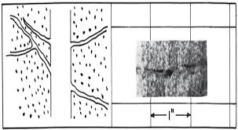
Causes of Lost circulation
Natural fractures causes :
natural fractures in formations, and cavernous
formations.
Through the openings in the rock in low pressure or
Depleted zones.

Slide 11
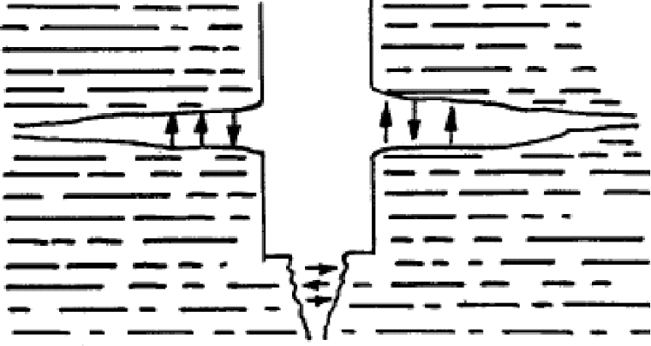
Causes of Lost circulation
Induced fractures causes:
mainly by poor drilling practices:
occurs when hydrastatic pressure of mud exceeds
the breaking strength of the formation
.
surging .

Slide 12
Lost circulation
Indication of lost circulation
How to prevent lost circulation ?
Flow out less then flow in.
Lack of flow
Increase string weight
Increase pump speed
causes loss of bottom hole pressure
Increase chance of taking a kich
Using proper mud weight
Conduct tests such as leak of test and formation integrity test.
Maintain good hole cleaning
Setting casing to protect upper weaker formations.

Slide 13
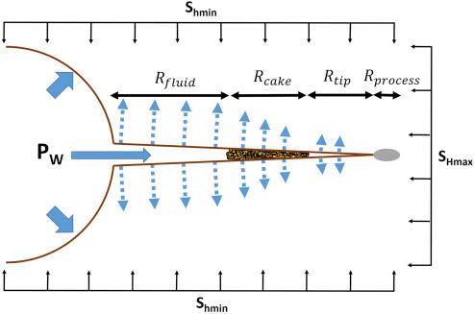
Mechanics of Fracturing
Induced fractures normally occur at the weakest part of formations. The requirements for forming fractures are pressure and surfaces upon which the pressure may act so that the resultant forces are of sufficient magnitude and are exerted in such a manner to part the formations
Where,
Pw = Wellbore Pressure;
Po = Pore Pressure;
Shmin = Minimum Horizontal Stress;
SHMAX = Maximum Horizontal Stress;
and įș = Effective Tangential (Hoop) Stress

Slide 14
MANAGEMENT OF EQUIVALENT CIRCULATION DENSITY (ECD)
Drilling programs are designed to control downhole pressures in order to eliminate high ecds that lead to induced fractures
The control can be achieved through manipulating mud properties such as density, viscosity, and fluid loss.
Equivalent Circulating density (ECD) is a function of the
following :
Annular space: the smaller the annular area, the greater the
ECDs will be.
Fluid rheology: higher viscosities will increase the ECDs.
Pump rate: the higher the rate, the higher the ECDs.
ECD FORMULA
ECD= Ptotal(0.052×TVD)
Where,
PTotal = Phydrostatic + Pfriction; PTotal = Total Annular Pressure; Phydrostatic = Hydrostatic Pressure;
Pfriction = Annular Friction Pressure;
TVD = True Vertical Depth

Slide 15
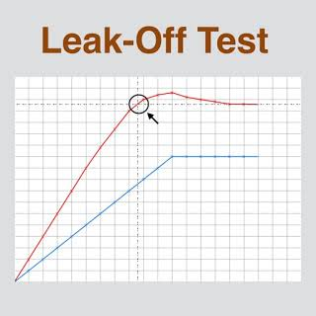
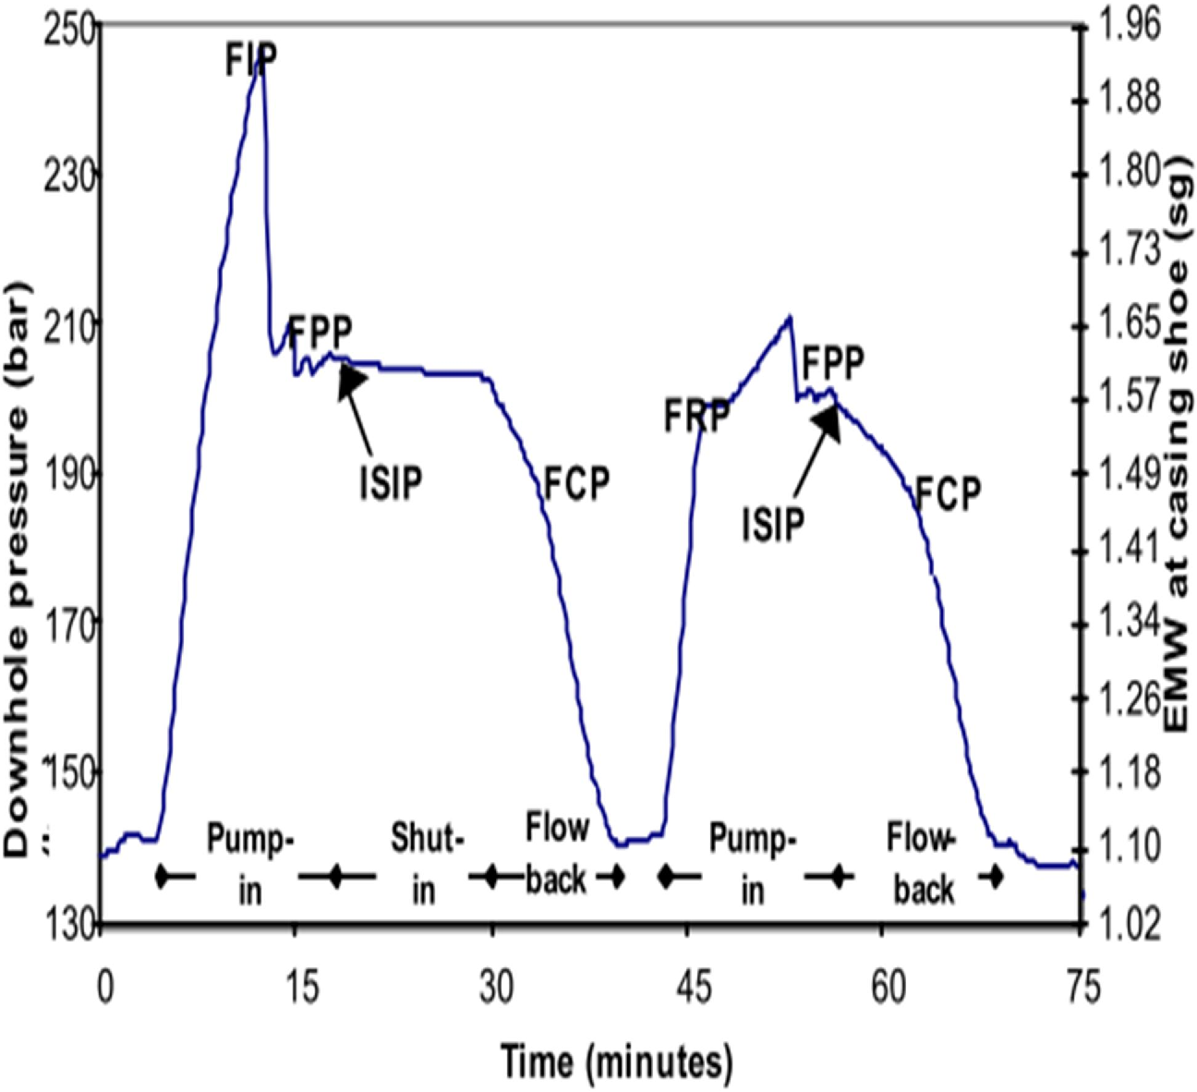
test data is often recorded manually at a coarse
sampling rate, disallowing raw data scrutiny.
some bias towards higher interpretations may even be
introduced by the drilling team’s eagerness to drill ahead.
leak-off pressures (lops) from a group of neighbouring wells are often
scattered, giving considerable room for subjective interpretation of local trend.
FIP: Fracture Initiation Pressure
FRP: Fracture Re-opening Pressure
FCP: Fracture Closure Pressure
ISIP: Initial Shut-in Pressure
FPP: Fracture Propagation Pressure

Slide 16
TYPES OF LOSSES IN THE LOST CIRCULATION

Slide 17
THANK YOU …

